Slide 1
MEC101
Mechanical Sciences-I
Chapter 5
Forces in Slender Members

Slide 2
An Interesting Reference
One can find a large number of interactive practice problems in a very good software MDSOLIDS which can be downloaded from:
www.mdsolids.com

Slide 3
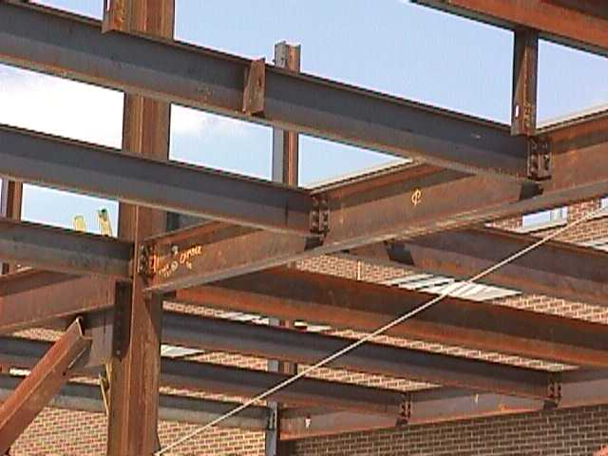
Introduction to Beams
A beam is a horizontal structural member used to support loads
Beams are used to support the roof and floors in buildings

Slide 4
Forces in Beams
Shear forces, V
Bending Moment, M

Slide 5
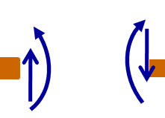
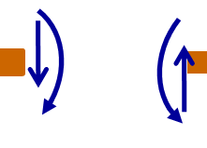
Sign Convention
y
_
+
x
Positive V & M
Negative V & M
+
-

Slide 6
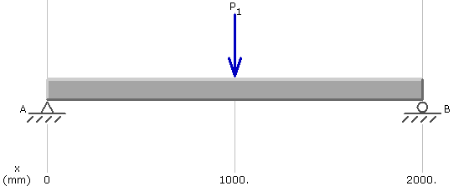
Sign Convention...
x
y
Negative Shear force
Positive Bending Moment

Slide 7
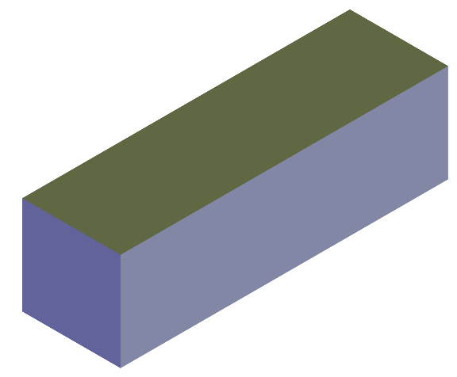
Origin of Shear Force
Shear Stresses
vary along the height

Slide 8



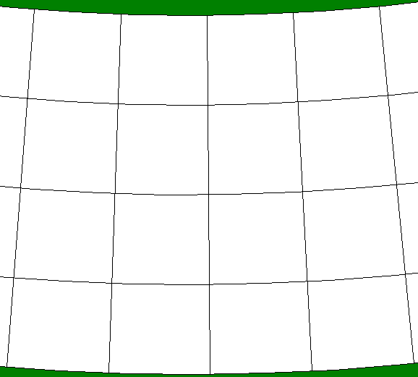
Origin of Resisting Moment
Compression near top
Extension near bottom

Slide 9
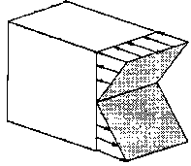
Origin of Resisting Moment
Net tensile force is zero!

Slide 10
Origin of Resisting Moment...
Extension near top
Compression near bottom

Slide 11
Bending Stresses in Beams
Net tensile force is zero!

Slide 12
Variations in Shear Force & Bending Moment
y
x
x
M – Px = 0, or M = Px

Slide 13
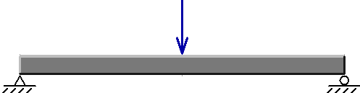
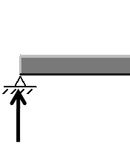
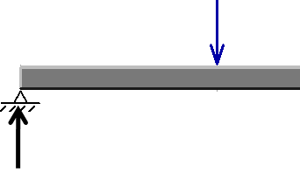
Shear Force & Bending Moment Diagrams
y
P
x
P/2
P/2
V = - P/2
x
V = + P/2
x

Slide 14
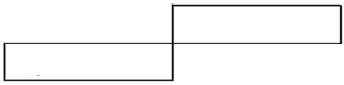
SFD & BMD
y
x
+ P/2
SFD
- P/2

Slide 15
SFD & BMD...
y
P
x
P/2
P/2
M – x(P/2) = 0
x
x
M – x(P/2) + (x – L/2)P = 0

Slide 16
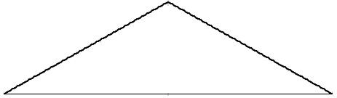
SFD & BMD...
y
x
+ P/2
SFD
- P/2
+PL/4
BMD

Slide 17
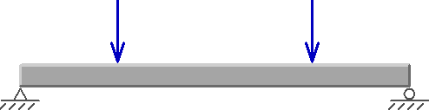
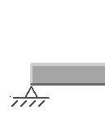
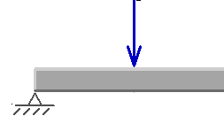
SFD & BMD: Another Example
y
P
P
P
P
x
P
V = - P
x
P
P
V = 0
x

Slide 18
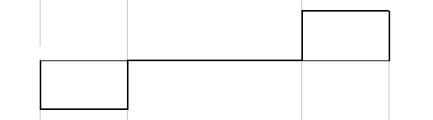
SFD & BMD: Another Example
y
P
P
P
P
x
+ P
SFD
- P

Slide 19
SFD & BMD: Another Example
y
P
P
P
P
x
M
M – xP = 0
P
P
x
P
M
P
x
M – xP + P(x – L/4)= 0

Slide 20
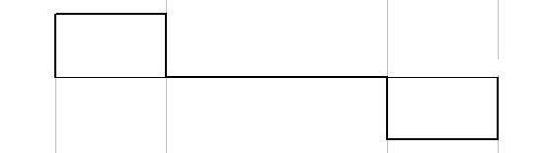
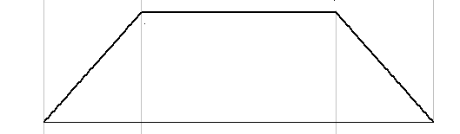
SFD & BMD: Another Example
y
P
P
P
P
x
+ P
SFD
- P
PL/4
BMD

Slide 21
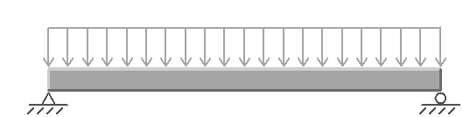
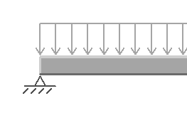
SFD & BMD: Another Example
y
w N/m
wL/2
wL/2
x
wL/2
V
x
V + wL/2 – wx = 0
Or, V = - wL/2 + wx

Slide 22
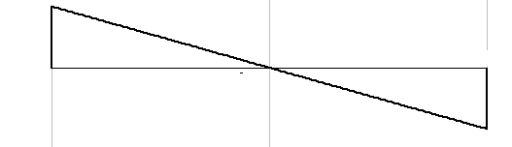
SFD & BMD: Another Example
y
w N/m
wL/2
wL/2
x
SFD
+ wL/2
x
- wL/2

Slide 23
SFD & BMD: Another Example
y
w N/m
wL/2
wL/2
x
wL/2
M
V
x
wx
M – (wL/2)x + wx²/2 = 0
Or, M = wLx/2 - wx²/2

Slide 24
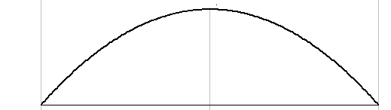
SFD & BMD: Another Example
y
w N/m
wL/2
wL/2
x
SFD
+ wL/2
x
- wL/2
wL²/8
BMD

Slide 25
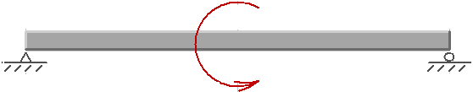
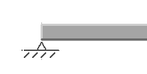
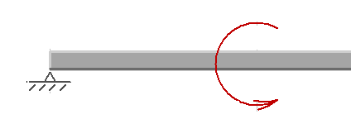
SFD & BMD: Another Example
y
M_{o}
M_{o}/L
M_{o}/L
●
x
M_{o}/L
V = - M_{o}/L
x
M_{o}
V = - M_{o}/L
M_{o}/L
●
x

Slide 26
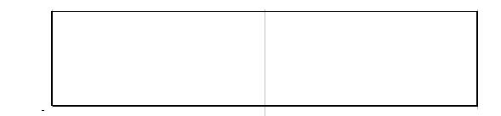
SFD & BMD: Another Example
y
M_{o}
M_{o}/L
M_{o}/L
●
x
x
SFD
- M_{o}/L

Slide 27
SFD & BMD: Another Example
y
M_{o}
M_{o}/L
M_{o}/L
●
x
M
M_{o}/L
M - M_{o}x /L = 0
M_{o}/L
x
M_{o}
M
M_{o}/L
●
M_{o}/L
x
M + M_{o} – M_{o}x/L = 0; or M = M_{o}x/L – M_{o}

Slide 28
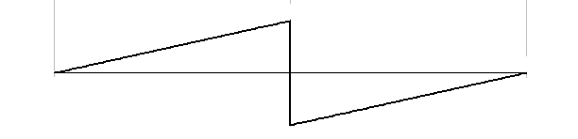
SFD & BMD: Another Example
y
M_{o}
M_{o}/L
M_{o}/L
●
x
x
SFD
- M_{o}/L
BMD
+M_{o}/2
x
-M_{o}/2

Slide 29
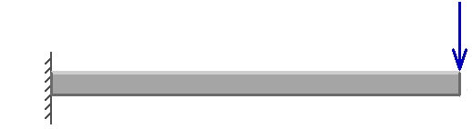
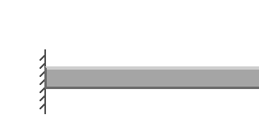
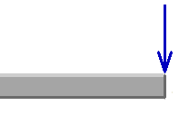
SFD & BMD: Another Example
y
P
P
PL
x
P
PL
V = - P
x

Slide 30
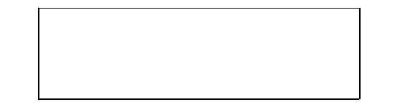
SFD & BMD: Another Example
y
P
P
PL
x
x
V
- P

Slide 31
SFD & BMD: Another Example
y
P
P
PL
x
M
P
PL
M + PL – Px = 0,
M = - P(L – x)
x
M + P(L – x) = 0,
M = - P(L – x)
P
M

Slide 32
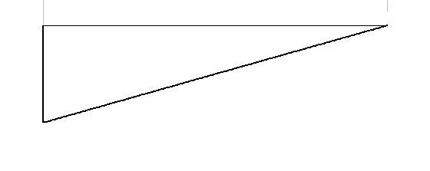
SFD & BMD: Another Example
y
P
P
PL
x
x
SFD
- P
x
BMD
- PL

Slide 33
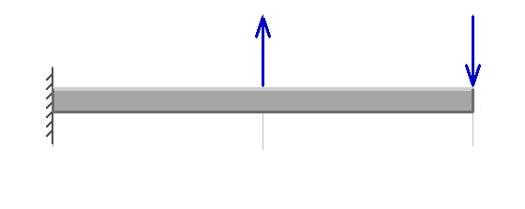
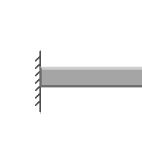
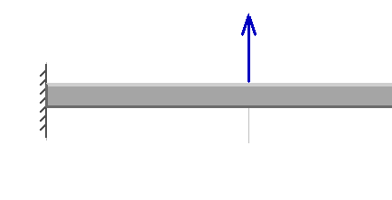
SFD & BMD: Another Example
y
P
P
PL/2
x
PL/2
V V = 0
P
PL/2
V V = - P

Slide 34
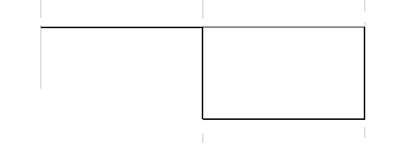
SFD & BMD: Another Example
y
P
P
PL/2
x
SFD
x
- P

Slide 35
SFD & BMD: Another Example
y
P
P
PL/2
x
M
PL/2
M + PL/ 2 = 0
P
M
PL/2
P
x
M + PL/ 2 – P(x – L/2) = 0, or
M = - PL/ 2 + P(x – L/2)

Slide 36
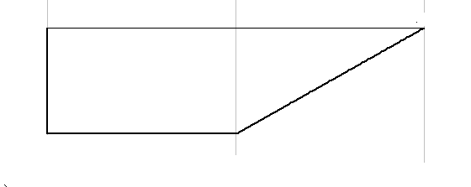
SFD & BMD: Another Example
y
P
P
PL/2
x
SFD
x
- P
x
BMD
- PL/2

Slide 37
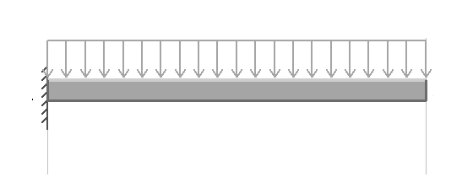
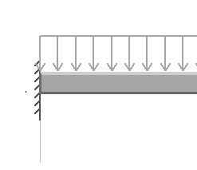
SFD & BMD: Another Example
w N/m
y
wL²/2
x
wL
wL
wL²/2
V
wL
x
wx
V + wL – wx = 0, or
V = - wL + wx

Slide 38
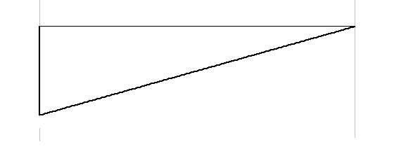
SFD & BMD: Another Example
w N/m
y
wL²/2
x
wL
SFD
x
- wL

Slide 39
SFD & BMD: Another Example
w N/m
y
wL²/2
x
wL
M
wL²/2
wL- wx
x
wL
wx
M + wL²/2 –wLx + wx²/2 = 0
or, M = wLx - w(L² + x²)/2

Slide 40
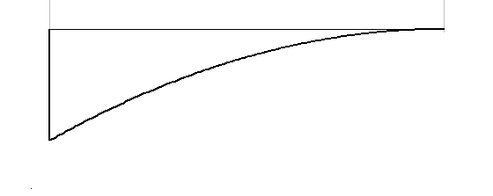
SFD & BMD: Another Example
w N/m
y
wL²/2
x
wL
SFD
x
- wL
x
BMD
- wL²/2

Slide 41
Comparison: Simply Supported vs. Cantilevered
w N/m
w N/m
+ wL/2
- wL/2
- wL/2
wL²/8
- wL²/2

Slide 42
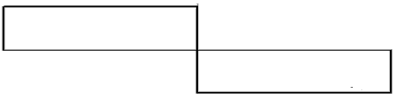
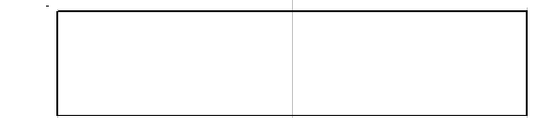
General Principle for SFD
wL/2
w
wL/2
P
P/2
P/2
wL/2
+ P/2
- P/2
- wL/2
M_{o}/L
M_{o}
P
P
●
M_{o}/L
P
P
P
-P
- M_{o}/L

Slide 43
General Principle for SFD
w
P
P
wL²/2
PL
wL
x
V
x
-P
-wL
P
P
PL/2
x
-P

Slide 44
Incremental Shear Force
F
V
dV = - F
V + dV
dx
w
V
V + dV
dV = - wdx
or dV/dx = -w
dx

Slide 45
General Principle for SFD
Start at zero.
Concentrated forces cause a jump in SFD at the location of the force.
Go up for every load downwards, down for every load upwards.
Distributed load downward will give a positive slope to the SF line.
Change in SF between any two locations is equal to (-ve of) the area under the distributed load curve.
The slope of the SFD at any location is equal to (-ve of) the distributed load strength (per unit length).

Slide 46
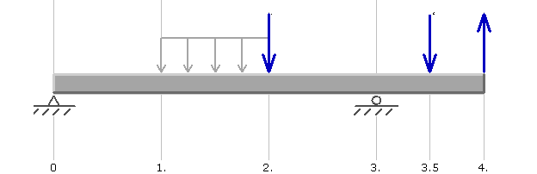
Constructing SFD
100 N
100 N
100 N
200 N/m
150
150
+50
+100
x
-150

Slide 47
General Principle for BMD
P
P
P
P
+ P
+ P/2
- P
- P/2
+PL/4
PL/4

Slide 48
General Principle for BMD
w N/m
wL/2
wL/2
M_{o}/L
M_{o}
M_{o}/L
●
+ wL/2
- M_{o}/L
- wL/2
wL²/8
+M_{o}/2
-M_{o}/2

Slide 49
General Principle for BMD
P
P
P
P
PL
PL/2
- P
- P
- PL
- PL/2

Slide 50
Incremental Bending Moment
M
M + dM
M + dM – M + Vdx = 0
V + dV
V
dx
dM = - Vdx
M
M_{o}
M + dM
●
M + dM – M + M_{o} = 0,
or dM = - M_{o}
dx

Slide 51
General Principle for BMD
Start at zero.
Concentrated Moments cause a jump in BMD at the location of the moment.
Go up for every –ve moment, down for every +ve moment.
The slope of the BMD at any location is equal to (-ve of) the SF value at that location
Change in BM between any two locations is equal to the (negative of) the area under the SFcurve.

Slide 52
Constructing BMD
100 N
100 N
100 N
200 N/m
150
150
+150
+100
+50
-150
206.25
200
+150
50

